Slide 1
Plans for Science Exploitation and Preservation Platform at ESAC
Christophe Arviset
ADASS 2017, BOF, 24/10/2017

Slide 2
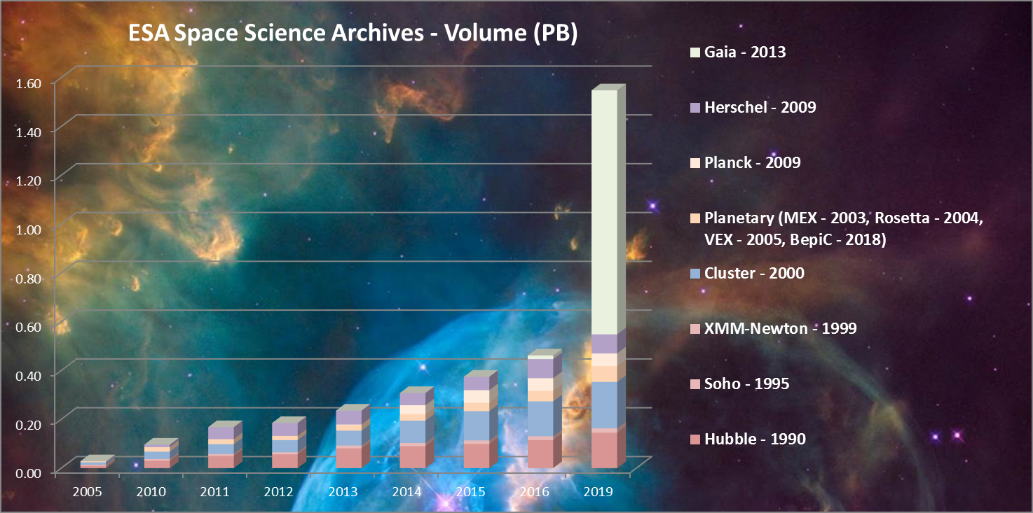
Euclid will add
150PB by 2025

Slide 3
Science Exploitation and Preservation Platform Drivers
Bring the code to the (BIG) data
Enable data processing where the data is
Interactive data analysis Jupiter notebook
Bring the code to the (small) data,
Enable easier access to standard data analysis software
on the fly creation of VM with full software environment
on the fly data processing (predefined data processing threads)
long term preservation of old software
Standard mission bulk data processing
Provide SW and science data processing capabilities as a “service”

Slide 4
Science Exploitation and Preservation Platform Drivers
Collaborative platform for data
Share your data (user disk space inside the archive, VOSpace, …)
Share your metadata (DB user space inside the archive, …)
Publish your data (VO protocols)
Collaborative platform for software
Pipeline development environment and testing
Share your code -> Science App Store

Slide 5

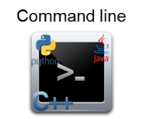
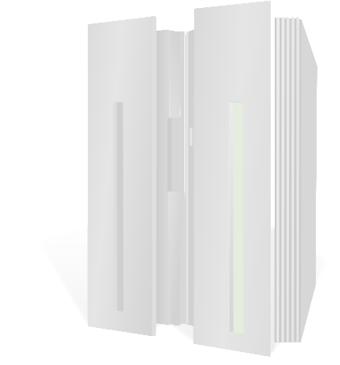



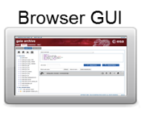


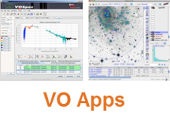
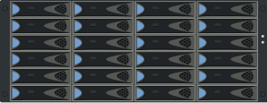

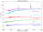
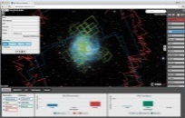
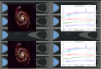


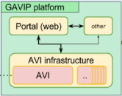
Gaia Archive Architecture
VObs protocols
TAP
archive
ADQL=Astronomical Data Query Language
HiPS=Hierarchical Progressive Survey
MOC=Multi-Order Coverage map
SAMP=Simple Application Messaging Protocol
SIAP=Simple Image Access Protocol
SSAP=Simple Spectra Access Protocol
TAP= Table Access Protocol
UWS=Universal Worker Service
TAP+ADQL
Query language
UWS
(job scheduler)
TAP
TAP
Database
SAMP
TAP, SSAP
Data Repository
TAP, HiPS, MOC
ESASky
VOSpace
User Work Space
SEPP
TAP
User
Disk
ftp

Slide 6

Current status and roadmap
Various proofs of concept
Users workspace (data and metadata) in Gaia Archive
DAS-LT (Data Analysis Software Long Term preservation)
PLAAVI (Planck Legacy Archive Added Value Interface)
GAVIP (Gaia Added Value Interface Platform)
Gathering requirements from various ESA missions for SEPP use cases
Design and implement 1st prototype in 2018+

